Slide 1
Transcriptional control of actuators
PMID 16330045
Notes:
You can build devices as sensors, actuators, and processes and then recombine them to link environmental phenomena to responses in cellular behavior.

Slide 2
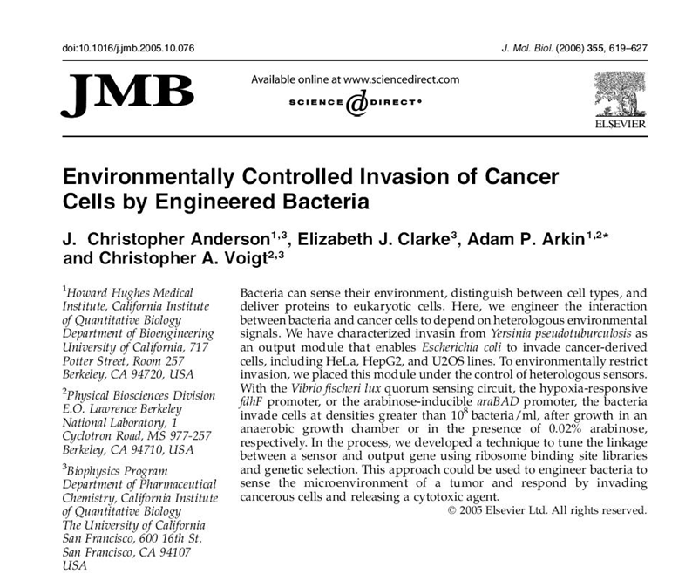
Notes:
In this study from my postdoctoral work, environmental cues of hypoxia or high cell density were linked to the ability of bacteria to invade cancer cells.

Slide 3
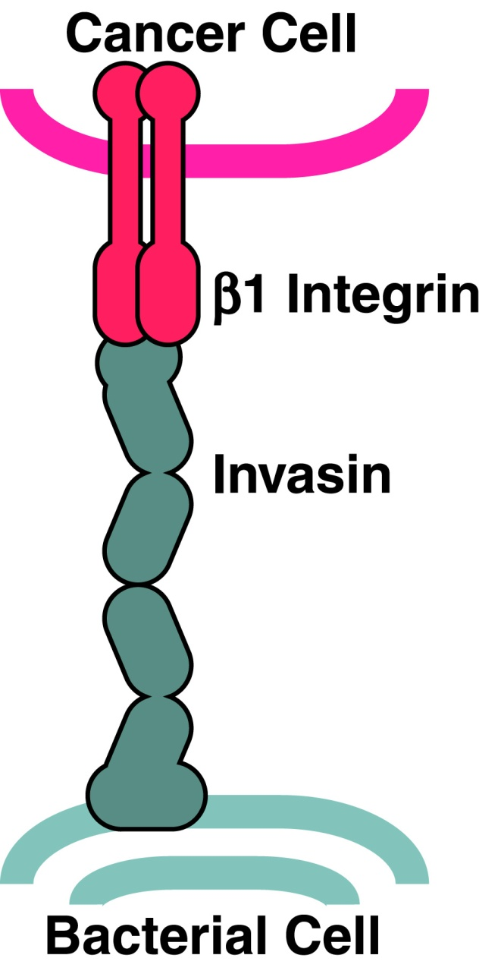
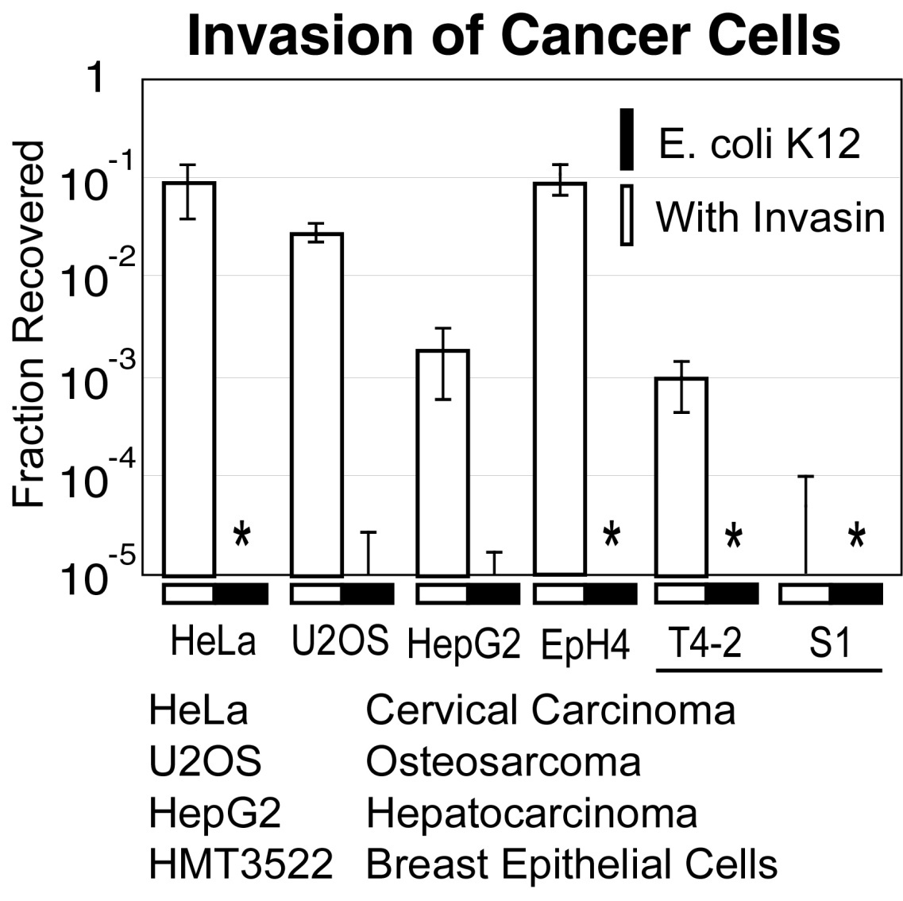
Invasion devices
Notes:
The actuator device in this study is a single-gene device encoding the Invasin protein. Invasin is a cell-surface localized protein that binds to beta1 integrins on the surfaces of mammalian cells. B1 integrins are a common cancer-associated epitope. This binding event results in highly efficient invasion of the bacterium into the cancer cell encapsulated in a phagocytic vacuole.
*
When you incubate inv+ E. coli with pretty much any cancer cell the bacteria efficiently invade, but negligible invasion is observed without invasin.
*
These HMT3522 cell lines aren’t quite cancer cells. The T4-2 cell lineage of HMT3522 is an immortalized tumorigenic line that is derived from the immortalized but non-tumorigenic S1 line. At this early progression towards cancer cells, the invasin bacteria are able to distinguish the healthy and harmful cells.

Slide 4
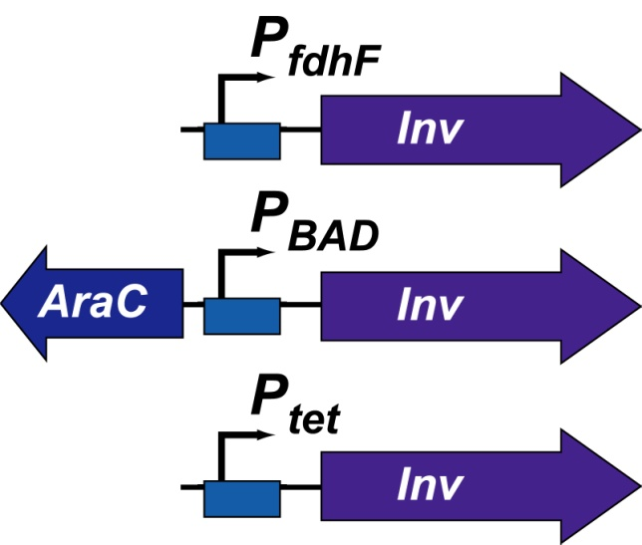
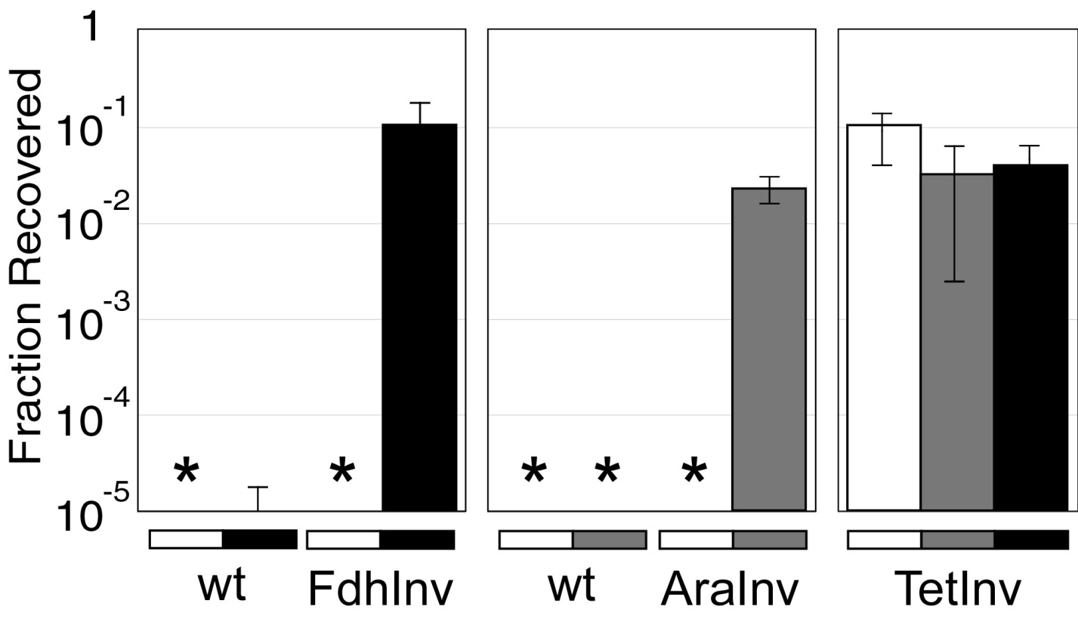
Environmentally-dependent invasion
FdhInv - Anaerobic Induction
AraInv - Arabinose Induction
TetInv - Constitutive
Anaerobic
Arabinose
Normal
Notes:
Using transcriptional control, it is possible to further narrow the conditions in which the bacteria invade. Here, different promoters are put in front of invasin. Placing invasin under the Pbad/AraC sensor results in bacteria that only invade cancer cells in the presence of arabinose. Placing the low-oxygen responsive fdhF promoter in front of invasin results in bacteria that only invade cancer cells under low oxygen conditions.

Slide 5
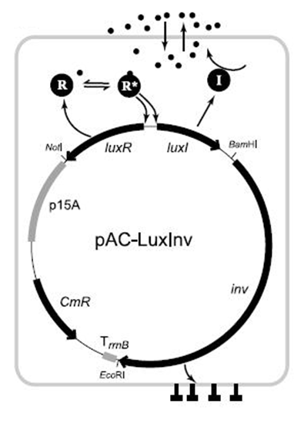
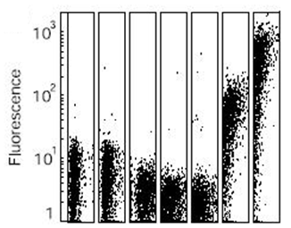
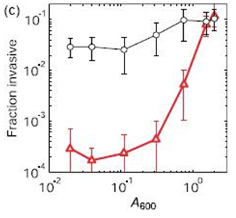
Density-dependent invasion
Notes:
More complex sensor devices can also control invasin. Here, the entire lux operon is placed in front of invasin. This quorem sensing device responds directly to homoserine lactone and indirectly to bacterial density.
*
In this cytometry trace, the lux sensor is placed upstream of GFP, and the data is flow cytometry of green fluorescence as a function of cell density. There is a sharp transition at the higher cell densities towards activation.
*
Here the same series of cell densities is scanned for the lux-invasin construct in red lines alongside the consitutively-expressed invasin in black lines. The bacteria are poorly invasive until they achieve a high cell density.

Slide 6
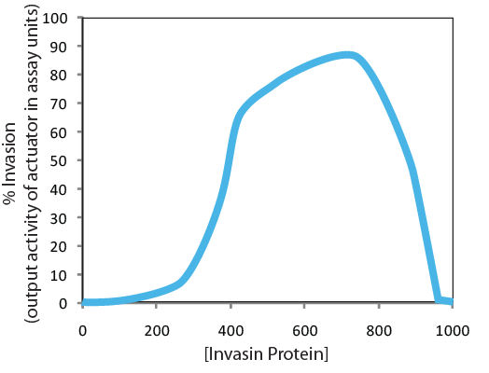
Transfer function matching
Notes:
One of the main challenge in joining sensors and actuators as new composite devices is the matching of input and output transcription levels. We speak of promoters and genes as being ‘on’ or ‘off’ but in practice we are always just altering rates of transcription and these are continuous variables. Thus, these are analog systems and not well thought of as digital. If you were to scan invasiveness as a function of invasin protein, it would have some curve that was monotonically increasing with increased expression up to some maximal value, and then toxicity issues would affect the viability and function of the bacteria beyond this maximum. Suppose this maximum occurs at a concentratin of 700 proteins.

Slide 7
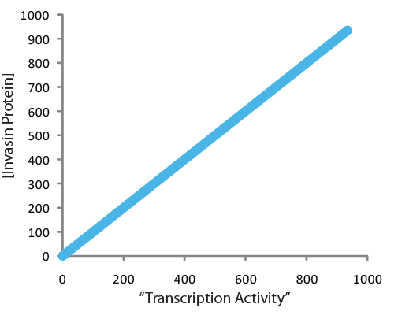
Transfer function matching
Notes:
We’ve seen that in the absence of additional translation control, protein expression levels are usually linear with respect to transcription activity.

Slide 8
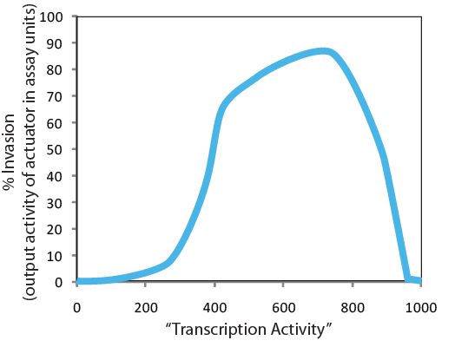
Transfer function matching
Notes:
Thus we can describe the actuators transfer function in terms of input transcription activity, and let’s suppose that this reaches a maximum around 700 transcripts per cell.

Slide 9
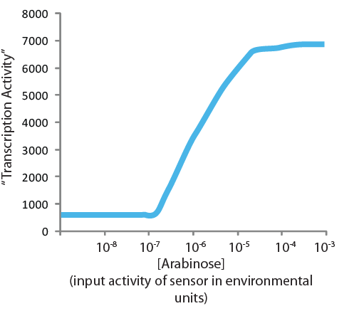
Transfer function matching
Notes:
Similarly we can describe the transfer function of the Pbad promoter system in terms of the transcript it generates as a function of input arabinose concentration.

Slide 10
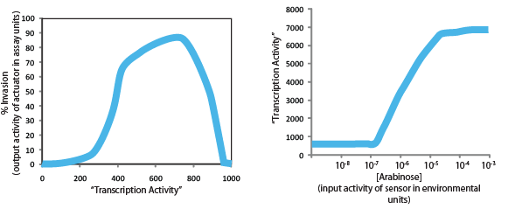
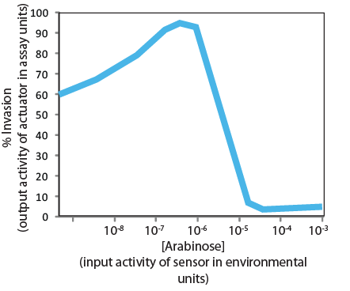
Transfer function matching
Notes:
We can infer the response of this system by merging these two transfer functions.
*
Suppose we grow the bacteria at 10^-5 molar arabinose. * We would expect a transcriptional output around 700 for the transciption rate. 700 transcripts puts us fairly close to the optimal invasiveness.
*
If we do this analysis for all concentrations of arabinose, we can predict the transfer function for invasion as a function of input arabinose concentration. Suprisingly, we get a very non-intuitive curve. The invasiveness has a high efficiency at all the low arabinose concentrations and a low invasiveness at the high arabinose concentrations! This miss-match between transfer functions is commonly observed in these aggregate devices, but fortunately they can usually be ‘fixed’ with a little tuning.

Slide 11
Transfer function matching
Notes:
The reostat that is easy to tune in this system is the curve relating transcription activity and translated protein.

Slide 12
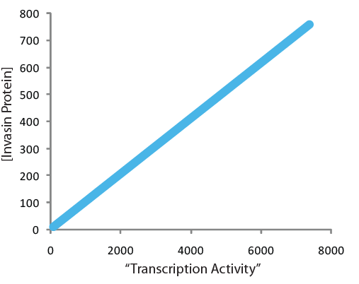
Transfer function matching
Notes:
If we simply tune the RBS, in this case by putting in a weaker translation rate, we can change this transfer function, and when we propagate this change through to the entire transfer function,

Slide 13
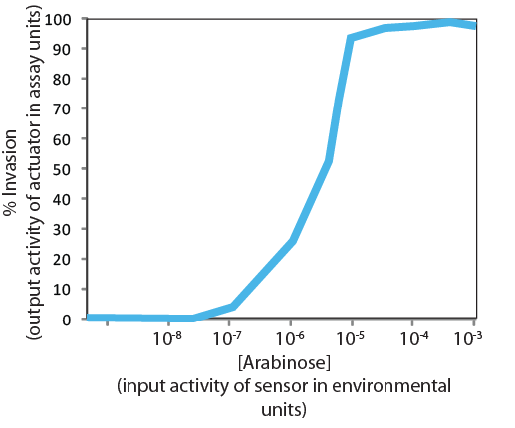
Transfer function matching
Notes:
We get the expected circuit response.

Slide 14
Transfer Studies
Notes:
The E. coli species is composed of many thousands of variant strains, some of which are pathogenic.

Slide 15
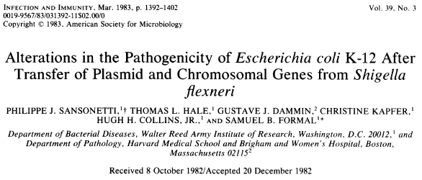
PMID 6341237
Notes:
In this study by Sansonetti and coworkers, they investigate what is the minimal set of genes needed to convert the laboratory K12 strain into a strain functionally equivalent to Shigella flexneri. Shigella is E. coli’s closest cousin on the phylogenetic tree, but from a clinical perspective the two organisms are quite different.

Slide 16
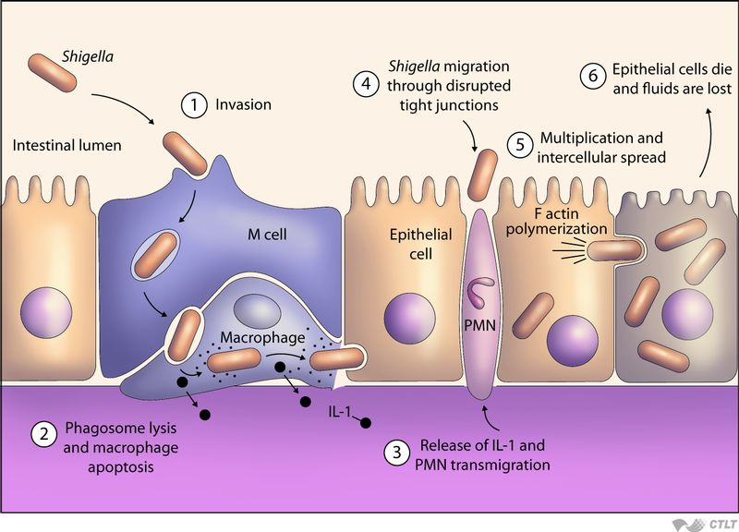
Notes:
While most strains of E. coli are harmless commensal bacteria, Shigella are usually pathogenic causing a particularly nasty form of dysentery. Shigella infects animals by oral ingestion and enters the intesines. Like many other pathogenic enterobacteria, Shigella invades M-cells and then macrophages. Shigella then bursts from the phagocytic vacuole and is able to spread from epithelial cell to epithelial cell by polymerizing actin from its poles. In this way it is able to jet around inside the cytoplasm of the cell and propel itself across cell junctions.

Slide 17
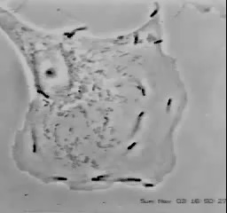
Actin polymerization
http://www.youtube.com/watch?v=sF4BeU60yT8
Notes:
This video is actually of Listeria, but a similar behavior of actin polymerization-based locomotion is observed when an epithelial cell is invaded by Shigella.

Slide 18
Transfer Studies
In this one, they ask the question what is the minimal set of virulence factors needed to make Shigella?
It gets at the question, what does it really take to make something a pathogen?
They reconstitute Shigella flexneri from E. coli K12 piece by piece starting with the virulence plasmid
pWR110 is the 220 kb virulence plasmid encoding the TTSS and effectors for invasion, escape, and cell-to-cell spreading
They put pWR110 in E. coli then start adding additional genomic loci and test them in 3 assays: HeLa cell model, in ligated rabbit ileal loops, or in the Sereny test
Notes:
The experiment they do in this study involves transferring regions of the shigella genome into E. coli K12 and then performing assays to determine what aspects of the pathogenic mechanism transfer. Experiments like this were very popular in the 80’s when much of what we know about the molecular basis of pathogenesis was unraveled. In this study they want to define what is the minimal set of virulence factors needed to make the shigella phenotype, and more globably they are getting at the question, what makes something a pathogen?
*
The reconstitute Shigella in K12 piece by pipece starting with the virulence plasmid.
*
Shigella encodes a 220 kb episomal DNA that is known to contain many of its virulence factors including its type III secretion systems and the genes for cell-to-cell spreading.
*
They put this plasmid into E. coli, and then start also adding genomic loci from shigella. Each variant strain is subjected to a battery of assays that each probe different aspects of the pathogenic mechanism.

Slide 19
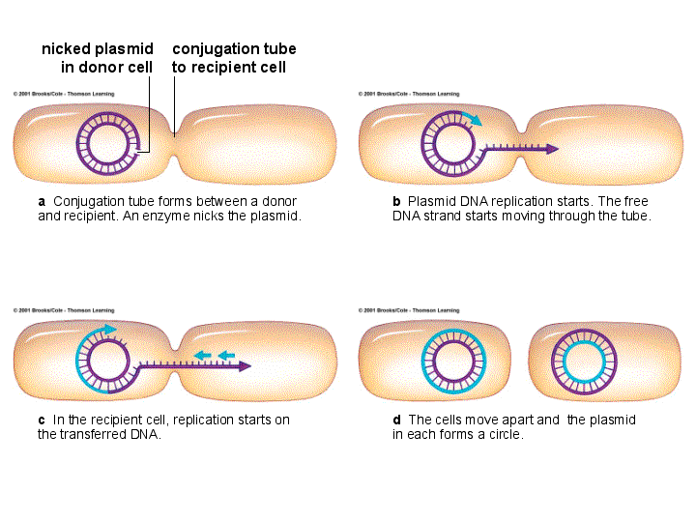
Transfer Studies
Start with 395-l cells (an MG1655 mutant) and mate in the virulence plasmid
Resulting strain is able to invade HeLa cells and escape the vacuole, but that’s it
Then start mating in genetic loci that have previously been shown necessary for Shigella to pass these assays using genetics experiments
Notes:
They start with strain 395-I of E. coli, which is a K12 MG1655 lineage strain, and they transfer in the virulence plasmid. At 220kb, transformation using conventional methods is inefficient, so usually such large DNAs are mobilized by conjugation methods instead of heat shocking or electroporating.
*
The resulting strain is able to invade HeLa cells and escape the vacuole, but all the other tests they perform fail
*
They then start putting in Shigella genome loci to see what else is required. At the time this study was performed, the genome of E. coli had not been sequenced and none of the tools like gene synthesis or PCR existed. Thus they performed their study using more traditional genetic mating experiments using conjugation. Conjugation is a process in which DNA is transferred from one DNA to another starting at specified loci. By controlling how long the bacteria are able to mate, you can control how much of the genome gets transferred.

Slide 20
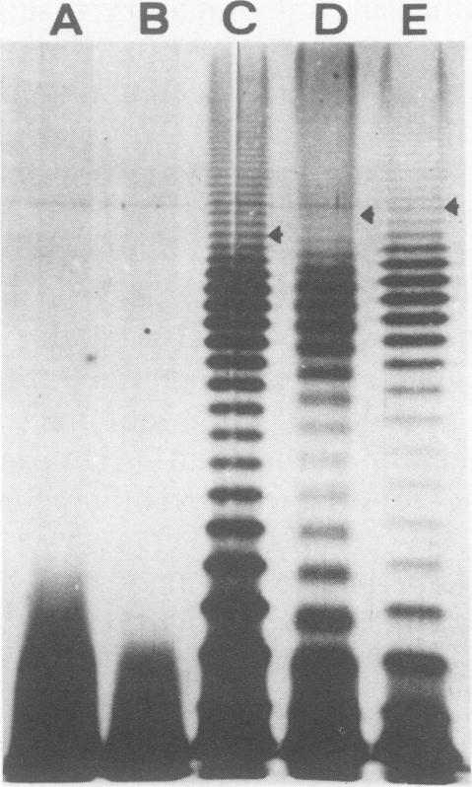
Transfer Studies
They show that transferring the his locus leads to polymeric O-antigens (gel at right)
“group-specific antigen 3.4” or “3,4 somatic antigen” refer to Shigella flexneri’s O-antigen, and it’s near the his locus
O-antigens are primarily to avoid phage infection and opsonization, but also can be necessary for the proper expression of other virulence factors
Notes:
The success of a mating experiment is known by the transfer of genes adjacent to the ones of interest. By starting with a histidine auxotroph, mating can result in repair of the growth defect and thus be selected. Thus, any virulence factors that lie near the his locus can be transferred and selected based on this phenotype switch. They show that transfer of the his locus leads to successful production of O-antigens.
*
“group-specific antigen 3.4” or “3,4 somatic antigen” refer to Shigella flexneri’s O-antigen, and it’s now known to be encoded near the his locus in Shigella.
*
O-antigens are primarily to avoid phage infection and opsonization, but also can be necessary for the proper expression of other virulence factors. Experimentally, there is a simple PAGE electrophoresis-based assay for detecting O-antigens and quantifying the degree of polymerization

Slide 21
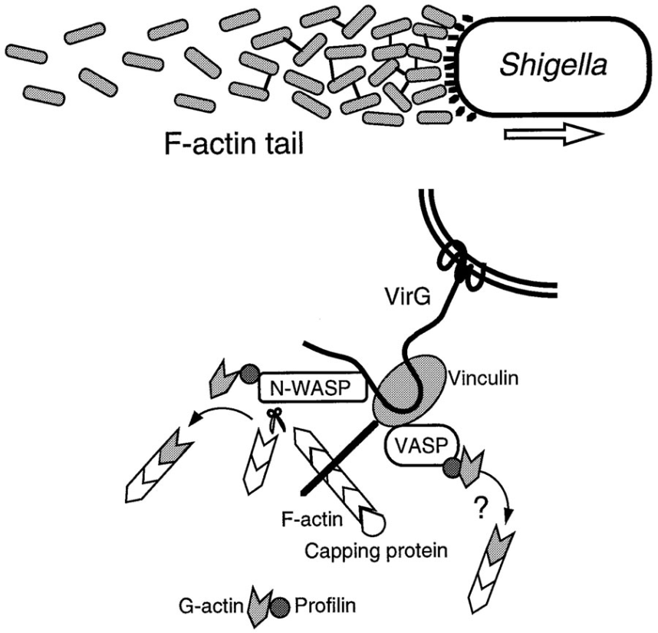
Transfer Studies
kcp is near the purE locus. Later studies revealed that the gene conferring the cell-to-cell spreading was ompT, a surface-expressed protease needed for functional expression of virG which is the actin-polymerizing protein
Transfer of the arg-mtl region was necessary for fluid production in rabbit ileal loop test, later this region has been shown to encode Shiga toxin
Notes:
Another locus that gives rise to phenotypes in their assays is virulence factors near the purE locus. Restoration of this locus results in bacteria that pass their tests for cell-to-cell spreading within a HeLa monolayer. They refer to this virulence factor as kcp, but later studies revealed that the gene conferring the cell-to-cell spreading was ompT, a surface-expressed protease needed for functional expression of virG which is the protein required for actin-polymerization-based locomotion.
*
Another important locus they found was associated with the arg-mtl region of the chromosome, and addition of this locus enables the bacteria to pass the rabbit ileal loop test. This assay quantifies fluid production which is a surrogate for extreme diarrheal effects observed during shigella infection. This region of the genome was later shown to encode Shiga toxin, which is confirmed to be necessary and sufficient for this phenotype.

Slide 22
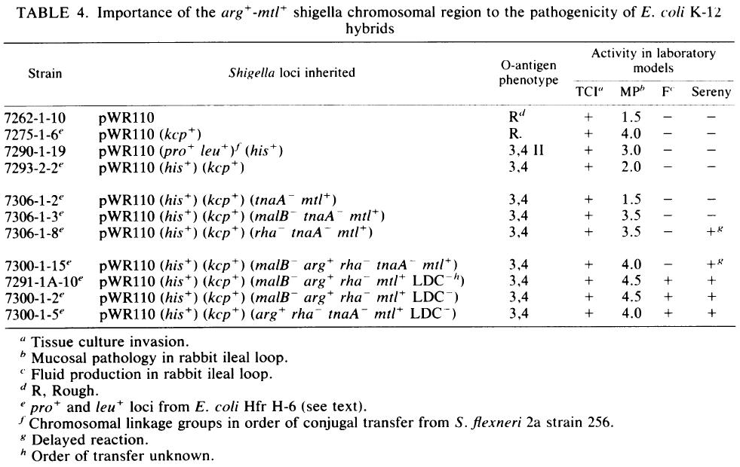
Summary of results
Using mating-based genetics, they show that you need to add the TTSS/effectors from the virulence plasmid, the O-antigen, ompT, and Shiga toxin to pass all the standard pathogenicity tests for Shigella
Does this study truly show that this set of genes is “sufficient” for virulence?
Notes:
The actual data of this study is a series of genetic compositions and what they do with respect to four different assays related to virulence. Using mating-based genetics, they show that you need to add the TTSS/effectors from the virulence plasmid, the O-antigen, ompT, and Shiga toxin to pass all the standard pathogenicity tests for Shigella
*
One question this study raises is whether this set of genes is truly “sufficient” for virulence? The claim of sufficiency is always problematic in biology because it is challenging to demonstrate that some other unknown factor is not contributing to the observed phenotype. Since E. coli and Shigella are so similar, it is entirely possible that they share genes that are also required for the observed phenotypes. However, this sort of transfer study allows very strong claims about what is required for a phenotype.
Another point to make about this study is that such things are rarely done anymore in large part due to biosafety concerns about potentially engineering pathogens in the lab. In fact, any experiment involving the transfer of virulence factors receives specific scrutiny under the NIH guidelines which regulate research in academia and indirectly in industry. Such experiments are considered potentially hazardous and require special review.

Slide 23
Transfer of virulence clusters
Notes:
Bacteria are known to frequently participate in horizontal gene transfer. As a result, genes related by a process are often clustered in the genome which enables them to more easily be transferred as a functional set. We can also use synthesis to intentionally move a set of related genes. One general question is, how often do such transfer experiments work, and where do they go awry?

Slide 24
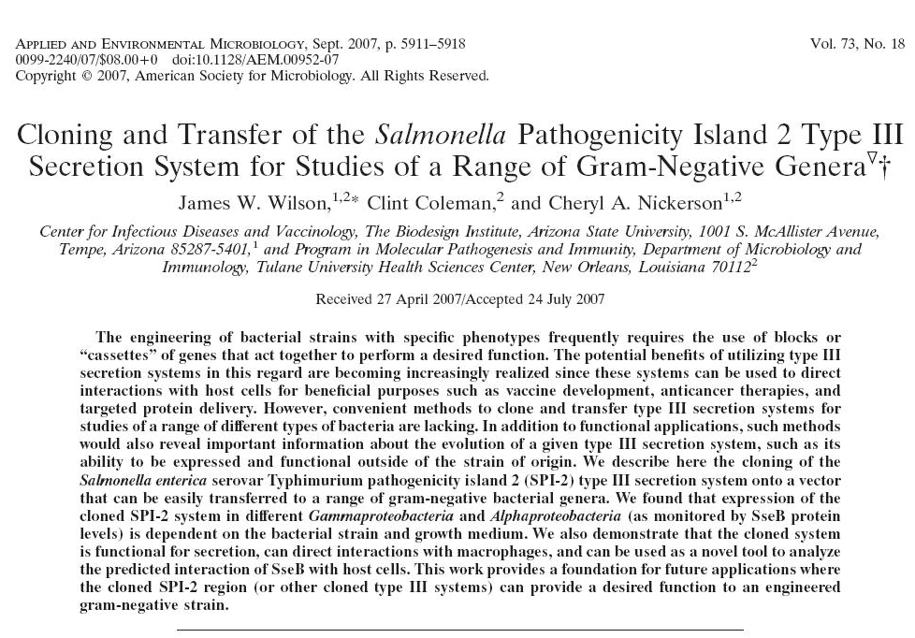
PMID 17675443
Notes:
In this study by Nickerson and coworkers, they exam the transfer of a type III secretion cluster called spi-2 from Salmonella to other gram-negative bacteria.

Slide 25
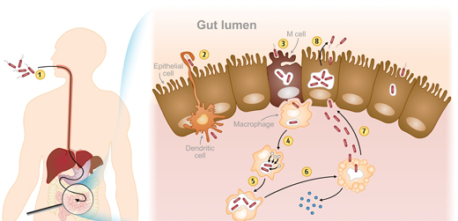
Notes:
When a mammal is infected with pathogenic strains of salmonella such salmonella typhimurium, the bacterium begins by invasion of M cells in the intestinal epithelium. This process involve a type III secretion system called SPI-1. As a result of invasion, the bacterium resides inside a phagocytic vacuole. Salmonella has a second type III secretion system called SPI-2 which secretes effector proteins that manipulate vesicular trafﬁcking and thereby enhance intracellular survival of the bacteria. This process is often referred to as ‘modifying the vacuole’ to prevent it from fusing with lysosomes.

Slide 26
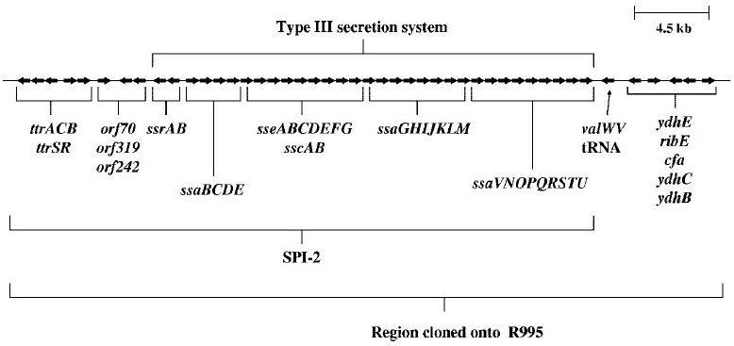
Transfer of TTSS to E. coli
Transferring TTSS into E. coli has a variety of biotech apps: making vaccines, protein production, therapeutic bacteria, manipulating macrophages
They put the SPI-2 TTSS on a conjugative plasmid and show it functions in E. coli
They do this to SPI-1 in another paper (PMID 16253373), but it doesn’t work in E. coli
Notes:
Like all secretion systems, type III secretion systems have been considered for biotech apps including use as vaccines, for protein production, therapeutic bacteria, and for manipulating the behavior of macrophages.
*
In this study, the authors put the SPI-2 TTSS on a conjugative plasmid and show that it functions in E. coli.
*
In another similar paper, they do this same experiment but with SPI-1 and show that it does not work in E. coli.

Slide 27
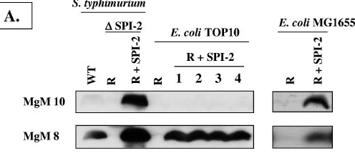
Test for function
Monitor SseB expression by Western blot to indicate whether SPI-2 is being expressed or not
SseB is a late-expressed chaperone needed to recruit proteins to the needle complex
Demonstrate secretion of an effector protein using a similar blot
MgM 8 is media that induces expression, MgM 10 doesn’t
They successfully observe SseB production in MG1655 and TOP10 (a modern lab strain)
Surprisingly get different induction behavior in MG1655
SPI-2 was not sufficient to allow survival within macrophages
Notes:
To show that it works, they monitor the expression of a protein called SseB, which is a late-expressed chaperon needed to recruit proteins to the needle complex. They also show that effector secretion happens using a similar blot assay.
*
They employ two media that are known to cause Salmonella to either express or not express SPI-2. These are called mgm8 and mgm10.
*
They successfully observe SseB production in MG1655 and TOP10 (a modern lab strain)
*
Surprisingly get different induction behavior in MG1655 than is observed in Salmonella, and that is a common refrain with such experiments – if something doesn’t work in a transfer experiment between two highly-related organisms, most likely it is the result of subtle differences in regulation between the two strains.
*Another question is whether SPI-2 is sufficient for some of the additional functions observed during salmonella infection. SPI-2 was not sufficient to allow survival within macrophages. This could mean that additional gene functions are required for this phenotype, or it could be an artifact of regulatory differences.
We saw in previous chapters how biosynthetic pathways can be moved from one organism to another and how replacing regulation often facilitates such transfers. This theme carries over to these other domains of biochemistry, and these complex microbiological processes often require some degree of refactoring to work.

Slide 28
Live Vaccines
Notes:
Live vaccines are one of the more advanced applications of engineered bacteria.

Slide 29
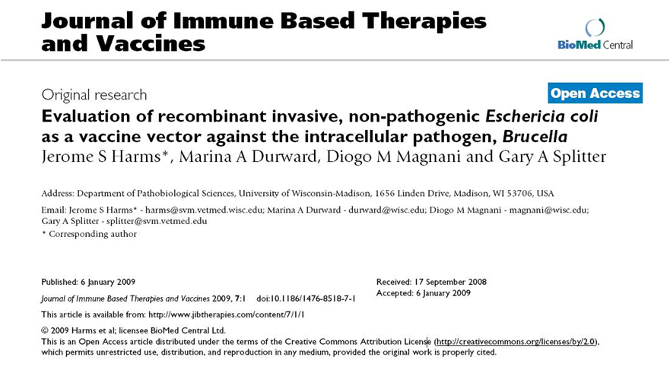
PMID 19126207
Notes:
In this study, Splitter and coworkers engineer laboratory strains of E. coli as a vaccine vector against the intracellular pathogenic bacterium Brucella.

Slide 30
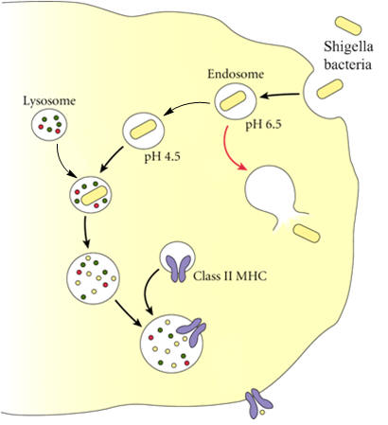
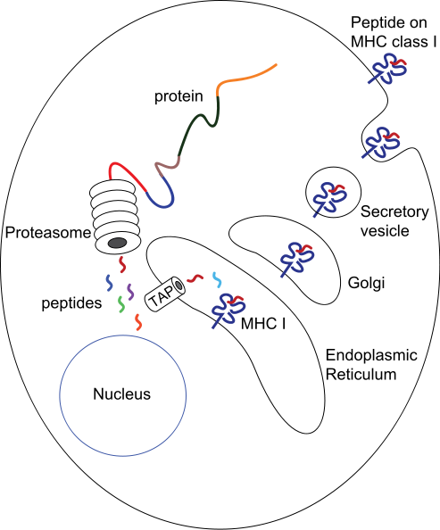
Class II MHC Display
Class I MHC Display
Notes:
What they are trying to do in this study is have the bacteria be engulphed by phagocytes and used to present Brucella peptides by MHC class I display. It is much easier to elicit type II MHC display. When typical bacteria are taken up by a macrophage, it enters a vacuole which will fuse with lysosomes, which result in destruction of the bacteria and degradation of its proteins. The resulting peptides are captured as class II MHC complexes and presented on the surface of the cell for binding to T-cell receptors on helper T cells. Class II display is the normal way that the immune system detects bacterially-infected cells.
*
Class I MHC display involves cytoplasmic proteins. Typically what happens is a virus infects the cell resulting in cytoplasmic production of viral proteins. The proteasome generates peptide fragments out of the viral proteins. These peptides are sampled by TAP and loaded into class I mhc molecules. These elicit binding to a different population of T-cells, the cytotoxic T-cells, which will kill these cells. Though it is not the normal order of events to elicit class I responses with a bacterium, it is possible to engineer bacteria that will do this, and the advantage is you can train the immune system to identify infected cells and kill them. This has utility for treating viral infections and cancer cells.

Slide 31
Brucella vaccine
Live vaccines derived from engineered bacteria are the largest area of therapeutic bacteria research, used to generate T cell responses (not B cell—TCRs not antibodies)
Invasin (from Yersinia pseudotuburculosis) expressed in E. coli allows them to invade cells expressing β1 integrin
Post invasion the bacteria are inside endocytic vesicles, which fuse with lysosomes, then get degraded, and peptides get displayed on class II MHC complexes
Listeriolysin (LLO) from Listeria monocytogenes can lyse the endocytic vacuole resulting in release of antigens to the cell’s cytoplasm when these bacteria infect macrophages or dendritic cells
Peptides in the cytoplasm can be displayed by class I MHC which helps the immune response
“However, the highly active LPS and PAMPS of E. coli may over stimulate the immune response to the vector. Engineering the E. coli genome to make the organism less stimulatory to the host would greatly improve the usefulness of this novel vaccine approach.”
Notes:
Live vaccines derived from engineered bacteria are the largest area of therapeutic bacteria research. They are used to generate T cell responses. All bacteria can elicit B cell responses and production of bacterium-specific antibodies, but typically bacteria don’t naturally cause cytotoxic T-cell responses.
In this study, they employ Invasin (from Yersinia pseudotuburculosis) expressed in E. coli to actively invade epithelial cells and macrophages and deliver peptides
Post invasion, the bacteria are inside endocytic vesicles, which fuse with lysosomes, then get degraded, and peptides get displayed on class II MHC complexes
If you also put Listeriolysin (or LLO) from Listeria monocytogenes into the bacteria, they will lyse the endocytic vacuole resulting in release of antigens to the cell’s cytoplasm when these bacteria infect macrophages or dendritic cells
Peptides in the cytoplasm can be displayed by class I MHC which can then elicit cytotoxic T-cell responses
One interesting thing they note is the the hypersensitivity of mammalian systems specifically to E. coli isn’t particularly advantageous here. Though they do wish to elicit immune responses, they don’t really want to initiate strong innate immune responses. Such responses are primarily the result of chemically specific moieties present in enterobacteria, most significant of which is the liposopolysaccharide moiety called LPS. They suggest that engineering the E. coli genome to make the organism less stimulatory to the host would greatly improve the usefulness of this vaccine approach.

Slide 32
Chassis modification
Notes:
A common refrain in the area of therapeutic bacteria is the problem of strong immune responses to the bacteria. Though there aren’t many engineering studies involving the alteration of these properties, there are a few.

Slide 33
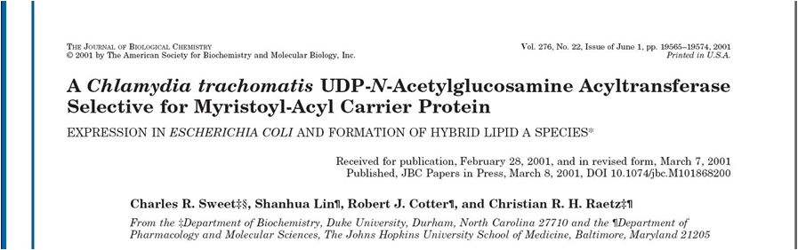
PMID 11279221
Notes:
In this study by Species and coworkers, the authors demonstrate that the outer membrane lipid can be altered to mimic the structure present in another bacterium, Chlamydia.

Slide 34
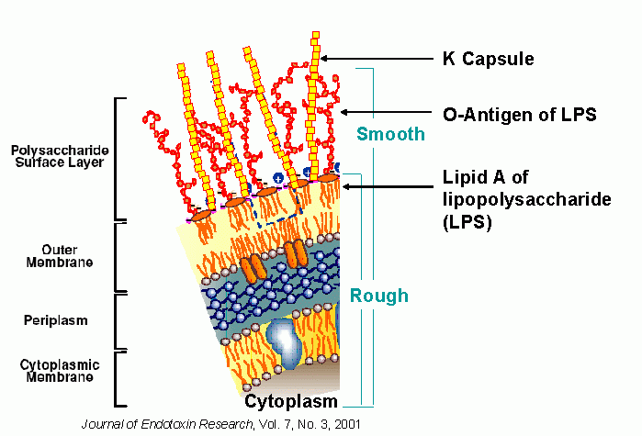
Modifying E. coli LPS
Notes:
If we examine the surface of a gram-negative bacterium, there is the cyotoplasm, then the inner membrane, then the periplasm, then the outer membrane. The lipid component of the outer membrane is called lipid A and is composed of a core oligosaccharide connected to six acyl chains. In your laboratory strains of E. coli, this is the extent of the cell’s surface. There aren’t additional modifications to the surface or to these lipids. In commensal and pathogenic strains of E. coli, there are additional carbohydrates called O-antigens that are covalently attached to the LPS. Additionally, there are often K capsules that are attached by lipid linkers to the outer membrane. Though these capsular polysaccharides play major roles in adaptive immunity and the protection of the bacterium from complement, they aren’t the feature of the bacterium that elicits strong innate immune responses. It is actually this lipid A moiety, the protein component of the outer membrane lipoprotein lpp, and various other signals that elicit these responses. Collectively they are referred to as PAMPS, or Pathogen-associated molecular patterns.

Slide 35
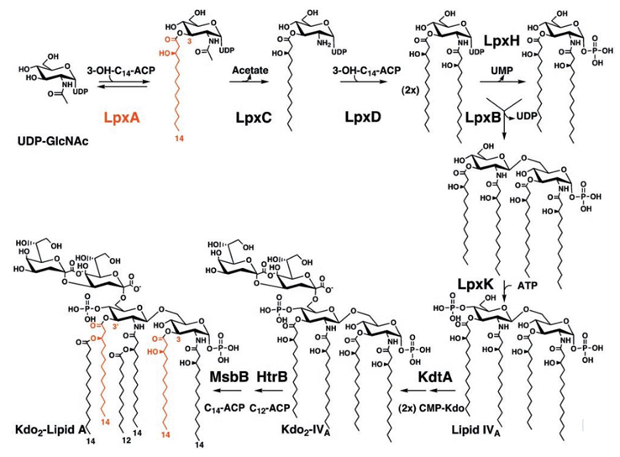
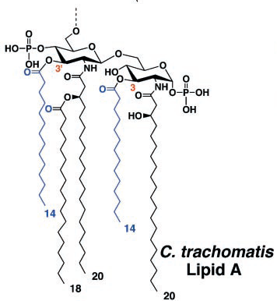
Modifying E. coli LPS
Notes:
In other bacteria such as Chlamydia and Legionella, this core lipid A moiety has a different structure and has a very different effect on the innate immune response. They actually antagonize the response. During normal lipid A biosynthesis, a series of transferase reactions assembles the oligosaccharide and decorates it with specific acyl chains at specific positions. Different bacterial genus produces different lipid A’s, and the variation is in the identity and number of sugars, the presence of phosphates, and the length, position, and count of acyl chains that get attached. Chlamydia produces a 5-acyl chain variant. It is known that often the pentaacylated lipid A’s are less stimulating of toll like receptor 4, and thus a weaker immune response.
*
If you mutate this last gene of the E. coli pathway, msbB, you get an entirely viable bacterium that decreases interleuken 2 responses in mice 2 fold and is reported to have an even stronger effect on the human immune system.

Slide 36
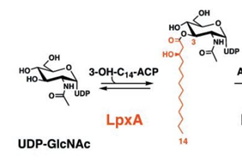
Modifying E. coli LPS
Here they swap out lpxA with the version from Chlamydia trachomatis
The resulting E. coli variants are viable and produce altered LPSs
Notes:
In this study, the authors swap out the first gene of the pathway for the cognate gene from chlamyidia. The resulting E. coli variants are viable and produce altered LPS’s.

Slide 37
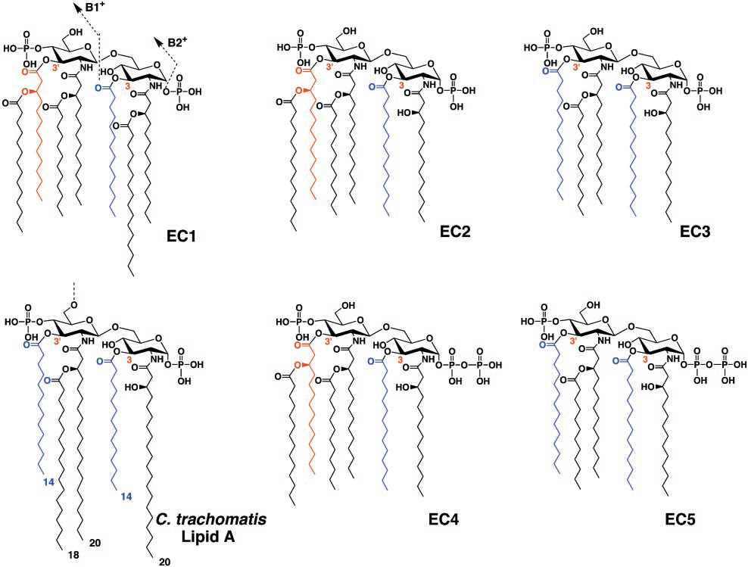
Chimeric LPS Products
Notes:
But it results in a spectrum of products. They end up with at least 6 different variants of LPS that are hybrids of the hexa- and penta-acylated variants.

